Slide 1
Neural Networks（神经网络原理）
Lecture 1: Introduction
  by Huafu Chen
SLST, UESTC, China
教材：Simon Haykin 著，叶世伟等译
机械工业出版社

Slide 2
(Artificial) Neural Network ?
Computational model
inspired from
neurological model of brain

Slide 3
1) Human brain computes in different way from digital computer
  highly complex, nonlinear, and parallel computing
  many times faster than d-computer in
    pattern recognition, perception, motor control
Notes:
Human brain computes in different way from digital computer (the von Neumann machine)

Slide 4
2) Human brain is much more clever than d-computer
  has great structure and ability to build up its own rules by experience ( learning )
    dramatic development within 2 years after birth
    continues to develop afterward
      Language Learning Device before 13 years old
Notes:
Human brain computes in different way from digital computer (the von Neumann machine)

Slide 5
3) Human brain is more robust than d-computer in general
  Plasticity of Brain : ability to adapt to its environment

Slide 6
Neural Network Definitions-1
Machine designed to model the way
in which brain performs tasks
implemented by electronic devices and/or software (simulation)
Learning is the major emphasis of NN
Notes:
definition in physical reality and fucntion

Slide 7
Neural Network Definitions-2
Massively parallel distributed processor
  massive interconnection of simple processing units
  simple processing units store experience and make it available to use
  knowledge is acquired from environment through learning process
Notes:
Definition mainly for its structure

Slide 8
Neural Network Definitions-3
Learning Machine
  modify synaptic weights to obtain design objective
  modify own topology - neurons die and new one can grow
Notes:
Functional definition

Slide 9
Neural Network Definitions-4
Connectionist network – connectionism
distributed and (mutual) connection among processing units
Notes:
Structural definition

Slide 10
Benefits of Neural Networks
Power comes from massively parallel distributed structure and learn to generalize
  generalization : ability to produce reasonable output for inputs not encountered during training
NN cannot provide solution of complex problem by working individually
  Complex problem is decomposed into simple tasks, and each task is assigned to a NN
  Long way to go to build a computer that mimic human brain

Slide 11
Benefits of Neural Networks
Non-linearity
  interconnection of non-linear neurons is itself non-linear
  desirable property, if the underlying physical mechanism is non-linear
Notes:
De’sirable

Slide 12
Benefits of Neural Networks
2. Input-Output Mapping
  input-output mapping is built by learning from examples
    By minimizing differences of desired NN response and actual response
  non-parametric statistical inference
    estimate arbitrary decision boundaries in input signal space

Slide 13
Benefits of Neural Networks
3. Adaptivity
  adapt synaptic weight to changes of environment
  NN is retrained to deal with minor change in the operating environment
    change synaptic weights in real-time
  more robust, reliable behavior in non-stationary environment
  Adaptive pattern recognition, signal processing and control
  stability-plasticity dilemma
Notes:
stability-plasticity di’lemma(二难推理；困境）：
To realize the fill benefits of adaptivity, the principal time constants of the system should be long enough for the system to ignore spurious disturbances and yet short enough to respond to meaningful changes in the environment.

Slide 14
Benefits of Neural Networks
4. Evidential Response ( pattern recognition )
  not only selected a class label but also provide confidence level
  confidences can be used to reject
    recognition accuracy vs. reliability
    ( do only you can do)
Notes:
Evi’dential Response
证据响应
Contextual Information processing
背景信息处理
Fault Tolerance
容错性 adverse 逆的 敌对的
VLSI- very larger scale integrated

Slide 15
Benefits of Neural Networks
5. Contextual Information processing
  (contextual) knowledge is presented in the structure
  every neuron is affected by others
Notes:
Evi’dential Response
证据响应
Contextual Information processing
背景信息处理
Fault Tolerance
容错性 adverse 逆的 敌对的
VLSI- very larger scale integrated

Slide 16
Benefits of Neural Networks
6. Fault Tolerance
  performance degrades gracefully under adverse condition
    catastrophic failure of d-computer
Notes:
Evi’dential Response
证据响应
Contextual Information processing
背景信息处理
Fault Tolerance
容错性 adverse 逆的 敌对的
VLSI- very larger scale integrated

Slide 17
Benefits of Neural Networks
7. VLSI implementability
Massively parallel nature makes it well suited for VLSI implementation
Notes:
Evi’dential Response
证据响应
Contextual Information processing
背景信息处理
Fault Tolerance
容错性 adverse 逆的 敌对的
VLSI- very larger scale integrated

Slide 18
Benefits of Neural Networks
8. Uniformity of Analysis and Design
  Neuron is common to all NN
  share theories and learning algorithms
  modular networks can be built thru seamless integration
Notes:
modular networks can be built thru seamless integration
模块化网络 可以用 模块的无缝集成 来实现

Slide 19
Benefits of Neural Networks
9. Neurobiological Analogy
  Living proof of fault tolerant, fast, powerful processing
  Neuroscientists see it as a research tool for neurobiological phenomena
  Engineers look to neuroscience for new ideas
Notes:
A’nalogy
学科相互 交叉 渗透

Slide 20
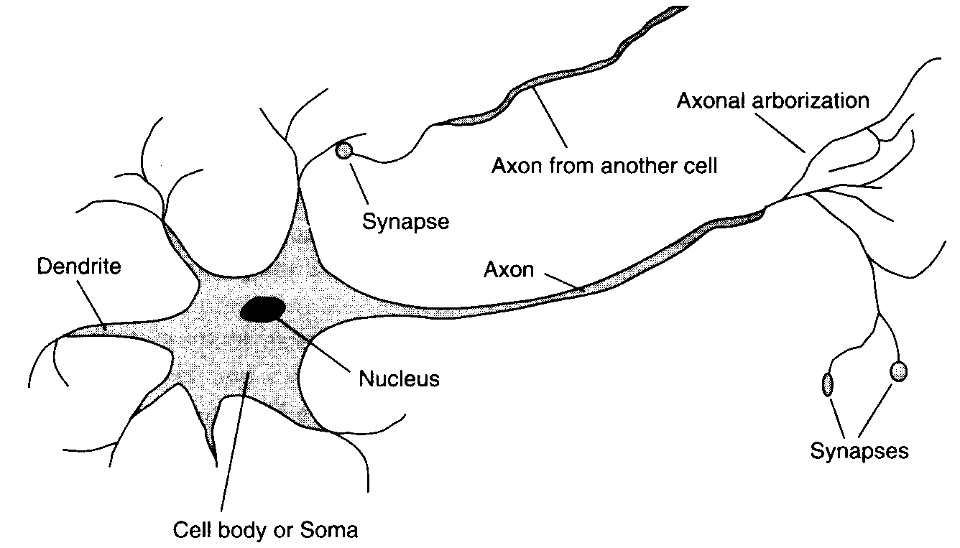
Biological Neuron
Excerpted from Artificial Intelligence: Modern Approach
by S. Russel and P. Norvig

Slide 21
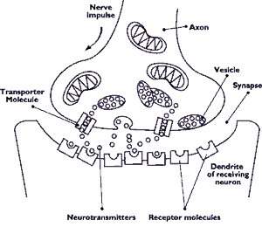
Neurotransmission
http://www.health.org/pubs/qdocs/mom/TG/intro.htm
Notes:
Vesicle 泡

Slide 22
Human Nervous System
Receptors
Neural Net
Effectors
stimulus
response
  10¹¹ neurons in human cortex
  60 x10¹⁰ synaptic connections
  10⁴ synapses per neuron
  10⁻³ sec cycle time (computer : 10⁻⁹ sec)
  energetic efficiency : 10⁻¹⁶ joules operation per second (computer : 10⁻⁶ joules)

Slide 23
Neuron structure
  nucleus, cell body, axon, dendrite, synapses
Neurotransmission
  Neuron’s output is encoded as a series of voltage pulses
    called action potentials or spikes
  electrical impulse effected by chemical transmitter
  Period of latent summation
    generate impulse if total potential of membrane reaches a level : firing
  excitatory or inhibitory
Cerebral cortex
  Areas of Brain for specific function
Notes:
Period of latent 潜伏期

Slide 24
Organization of Levels in Brains
Central Nervous sys
map into cerebral cortex
pathways, columns, topographic maps; involve multiple regions
neurons of similar and different properties, 1 mm in size, localized region in the brain
100μm in size, contains several dendrite trees
Assembly of synapses (silicon chip), milisecond, μm
most fundamental level (transistor)
Interregional circuits
Local circuits
Neurons
Dendrite tree
Neural microcircuits
Synapses
Molecules
Notes:
Assembly of synapses 突触组

Slide 25
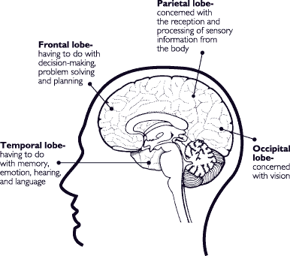
Cerebral Cortex
http://www.health.org/pubs/qdocs/mom/TG/intro.htm

Slide 26
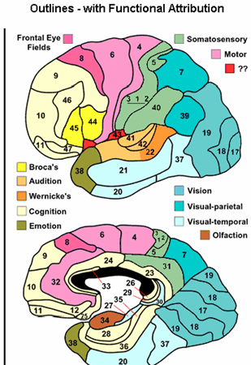
Functional Areas of the Brain

Slide 27
Models of Neuron (definition)
(1). Neuron is information processing unit
(2). A set of synapses or connecting links
  characterized by weight or strength
(3). An adder
  summing the input signals weighted by synapses
  a linear combiner
(4). An activation function
  also called squashing function
    squash (limits) the output to some finite values
Notes:
squash (limits) the output to some finite values
squash function 压制函数

Slide 28
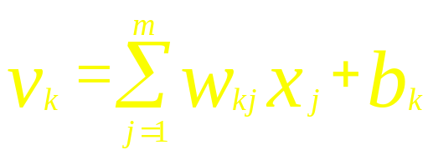
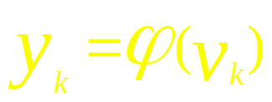
Nonlinear model of a neuron (I)
Bias
b_{k}
x₁
w_{k1}
Activation
function
x₂
w_{k2}
Σ
v_{k}
ϕ(.)
Output
y_{k}
...
...
x_{m}
w_{km}
Summing
junction
Input
signal
Synaptic
weights

Slide 29
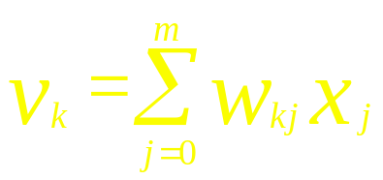
Nonlinear model of a neuron (II)
X₀ = +1
w_{k0}
W_{k0} = b_{k} (bias)
x₁
w_{k1}
Activation
function
x₂
w_{k2}
Σ
v_{k}
ϕ(.)
Output
y_{k}
...
...
x_{m}
w_{km}
Summing
junction
Input
signal
Synaptic
weights

Slide 30
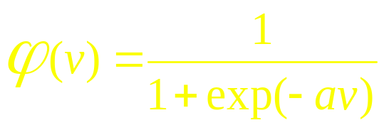
Types of Activation Function
O_{j}
O_{j}
O_{j}
+1
+1
+1
t
in_{i}
in_{i}
in_{i}
t
Threshold Function
Piecewise-linear
Function
Sigmoid Function
(differentiable)
a is slope parameter

Slide 31

Activation Function value range
+1
+1
v_{i}
v_{i}
-1
Hyperbolic tangent Function
Signum Function

Slide 32
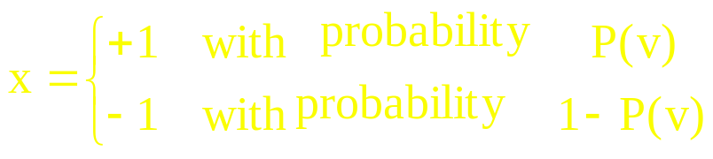
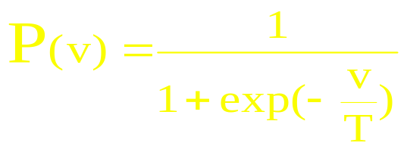
Stochastic Model of a Neuron
Deterministic vs stochastic
stochastic : stay at a state with probability
    x: state of neuron
    v: induced local field
    P(v) probability of firing
        where T is pseudotemparature
        T → 0, reduced to deterministic form

Slide 33
Neural network as directed Graph
Block diagram can be simplified by the idea of signal flow graph
node is associated with signal
directed link is associated with transfer function
  synaptic links
    governed by linear input-output relation
    signal x_{j} is multiplied by synaptic weight w_{kj}
  activation links
    governed by nonlinear input-output relation
    nonlinear activation function
Notes:
Neural network as directed Graph
看作有向图的神经网络

Slide 34
Signal Flow Graph of a Neuron
x₀ = +1
W_{k0} = b_{k}
x₁
w_{k1}
w_{k2}
v_{k}
ϕ(.)
x₂
y_{k}
...
w_{km}
x_{m}
synaptic links
activation links
Notes:
信号流图：主要包括 “节点” （与信号对应） 和 “有向连结” （对应处理部分） 两部分

Slide 35
Architectural graph of a Neuron
Three graphical representations
  Block diagram - providing functional description of a NN
  ppt.page.28
  Signal flow graph - complete description of signal flow
  ppt.page.33
  architectural graph - network layout （simplified signal flow graph)
Notes:
为研究 neuron 之间的信息传递情况 时用的简化图
Block diagram - providing functional description of a NN
(Fig.1-5,page 11, or 1-7, page 13) ppt.page.28
Signal flow graph - complete description of signal flow
( Fig.1-9, 1-10, page 16-17) ppt.page.33
architectural graph - network layout （simplified signal flow graph)
(fig. 1-11, page 18)

Slide 36
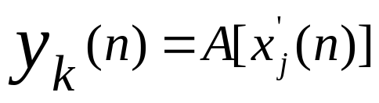

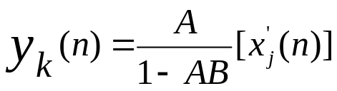
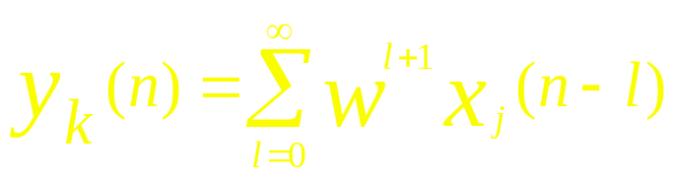
Feedback
Output determines in part own output via feedback
depending on w
  Stable (|w| <1– exponential convergent), linear divergence (|w| =1), exponential divergence (|w| >1)
  we are interested in the case of |w| <1 ; infinite memory
    output depends on inputs of infinite past
NN with feedback loop : recurrent network
x_{j}’(n)
A
w
y_{k}(n)
x_{j}(n)
B
z⁻¹
Notes:
recurrent network
递归网络
Stable (|w| <1– exponential convergent), linear divergence (|w| =1), exponential divergence (|w| >1) ( Fig.1.14, page 20)

Slide 37
Network Architecture
Single-layer Feedforward Networks
Multilayer Feedforward Networks
Recurrent Networks
Notes:
The details see the following three slices

Slide 38
Network Architecture
Single layer
Single-layer Feedforward Networks
  input layer and output layer
    single (computation) layer
  feedforward, acyclic ( no loop)
Notes:
Architectural graph of a Neuron
Computation node : shaded （计算单元）Acyclic 非周期性的 非循环的
source node : small square （输入）

Slide 39
Network Architecture
Multiple layer
fully connected
Multilayer Feedforward Networks
  hidden layers - hidden neurons and hidden units
  enables to extract high order statistics
  4-4-2 network
  fully connected layered network
Notes:
Architectural graph of a Neuron
Computation node : shaded （计算单元）
source node : small square （输入）

Slide 40


Network Architecture
Recurrent Networks
  at least one feedback loop
  with or without hidden neuron
Unit delay
operator
Recurrent network
without hidden units
And without
self-feedback
loops
outputs
inputs
Recurrent network
with hidden units
Notes:
Architectural graph of a Neuron
Computation node : shaded （计算单元）
source node : small square （输入）
不直接提供输出的神经元都是 hidden units
Recurrent network
without hidden units
And without
self-feedback
loops
(fig.1-17, page 23)

Slide 41
Knowledge Representation
Knowledge refers to stored information or models used by a person or machine (NN et al) to interpret, predict and appropriately respond to the outside world
Primary characteristics/requirement of knowledge representation
  What information is actually made explicit;
  How the information is physically encoded for the subsequent use
Good solution depends on good representation of knowledge
Notes:
Knowledge Representation
知识表示, books
知识表示的一般特点/要求： 那些信息需要明确表示，这些信息是如何被物理地编码以便后续利用
In NN, knowledge is represented by internal network parameters
real challenge

Slide 42
Knowledge Representation
In NN, knowledge is represented by internal network parameters
  real challenge
  Major task of NN is to learn a model of the world
Knowledge of the world
  world state represented by known facts - prior knowledge
  Observations/measurments - obtained by (noisy) sensors; training examples
Notes:
Knowledge Representation
知识表示, books
知识表示的一般特点/要求： 那些信息需要明确表示，这些信息是如何被物理地编码以便后续利用
In NN, knowledge is represented by internal network parameters
real challenge

Slide 43
Knowledge Acquisition by NN Training
Training examples : either labeled or unlabeled
    labeled: input signal and desired response
    unlabeled: different realizations of input signal（unsupervisored)

Slide 44
Knowledge Acquisition by NN Training
Examples
(A). Handwritten digit recognition
  1. Appropriate architecture is selected for NN
    source node = number of pixels of input image
    10 output node for each digit
    subset of examples for training NN
    by suitable learning algorithm
  2. Recognition performance is tested by the rest of the examples

Slide 45
Knowledge Acquisition by NN Training
(B).Training by both Positive and negative examples
    Such as a passive sonar detection problem
    positive examples: containing target (submarine)
    negative examples: marine life ( tell the network not confuse marine life with the target).
Notes:
Page 25 for a passive sonar detection problem

Slide 46
Rules of Knowledge representation in NN
Similar input from similar classes produce similar representations/(and/or output)
  similarity measures
    Euclidian distance, dot (inner) product/ cos
    random variable : Mahalanobis distance/...
2. Separate classes produce widely different representations
Notes:
1. Similar input from similar classes produce similar representations/(and/or output)
similarity measures
Euclidian distance, dot (inner) product/ cos
random variable : Mahalanobis distance/ page 27 eq.(1.27)
...

Slide 47
Rules of Knowledge representation in NN
3. More neurons should be involved in representation of more important feature
  probability of detection / false alarm
4. Prior information and invariances should be built into the design of the network
  general purpose vs specialized

Slide 48
Building Prior to NN design
Specialized structure
  learns fast because of small free parameters
  runs fast because of simple structure
No well-defined rules for building specialized NN
  ad hoc approach
  restricting the network architecture thru use of local connection
    receptive field
  Constraining the choice of synaptic weights
    weight sharing, parameter tying
Notes:
Tie -- 的现在分词 tying 绑定

Slide 49
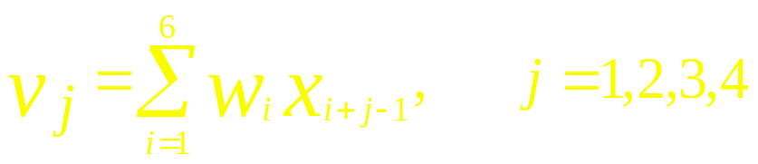
x₁
x₂
x₃
x₄
x₅
y₁
x₆
y₂
x₇
x₈
x₉
Combining receptive field and weight-sharing
(convolution network)
x₁₀
Notes:
receptive field 感受野 /接受域
Fig.1.20 page 28

Slide 50
Building invariance to NN design
Want to be capable to cope with transformations
  Invariance by structure
    synaptic connections are arranged not to be affected by the transform
    rotation invariant forcing w_{ji} = w_{jk} for all k / i in the same distance from the center j of image
  Invariance by training
    train by data of many different transformations
    computationally infeasible
  invariant feature space
    use obtained invariant features to NN for further classification
Notes:
computationally infeasible
// too much computation

Slide 51
Building invariance to NN design
No well-developed theory of optimizing architecture of NN
NN lacks explanation capability
Notes:
computationally infeasible
// too much computation

Slide 52
AI and NN
Definition and Goal of AI (artificial intelligence)
  art of creating machine that performs tasks that requires intelligence when performed by people
  study of mental faculties through the use of computational models
  to make computers to perceive, reason and act
  to develop machine that perform cognitive tasks
functions of AI system
    store knowledge
    apply the knowledge to solve problems
    acquire new knowledge thru experience
Notes:
Faculty 本领 才能

Slide 53
AI and NN
Key components of AI
  Representation (store )
  Reasoning (application)
  Learning
  (acquire new knowledge)
representation
learning
reasoning
Notes:
Faculty 本领 才能

Slide 54
AI
AI is goal, objective, dream
NN is a model of intelligent system
  it is not the only system
  Intelligent system is not necessarily same as human
    Example : Chess machine
Symbolic AI is a tool, paradigm toward AI
NN can be a good tool toward AI

Slide 55
Representation in Symbolic AI
Knowledge is represented By symbol structure
  symbolic AI
  well suited for human-machine communication
Knowledge is just data
  declarative
    represented by facts
    general inference procedure is used to manipulate the facts
    PROLOG （逻辑程序语言）
  procedural
    knowledge is embodied in executable code
    LISP （过程式语言）
Notes:
在符号的AI中，知识用 符号结构来表达
可以是描述性的知识
也可以是程序性的知识
PROLOG 逻辑程序设计语言 -被认为是智能化应用开发的强大工具，日本曾用它来开发 第五代计算机系统
LISP 过程式语言 LISP的符号表达式计算能力而不是数字使它便于AI程序
Declarative 说明性的
procedural
程序性的

Slide 56

Reasoning
Reasoning is ability to solve problem
  must able to express and solve broad range of problems
  must able to make explicit/implicit information known to it
  must have control mechanism to select operators for a situation
Problem solving is a searching problem
deal with incompleteness, inexactness, uncertainty
  probabilistic reasoning, plausible reasoning, fuzzy reasoning
Notes:
Plausible 似乎可能的

Slide 57
Learning
Model of Machine Learning （four compartments)
  Environment
  Learning element
  Knowledge base
  performance cycle
Inductive learning （归纳学习）
  generate rules from raw data
  similarity-based learning, case-based reasoning
deductive learning （推理学习）
  general rules are used to determine specific facts
  theorem proving
Augmenting knowledge-base is not a simple task
Notes:
Inductive learning 归纳学习
Deductive learning 推理学习
Augmenting –扩大， 增加， 增长
Model of Machine Learning (Figure 1.25/page 35) （four compartments)

Slide 58
Symbolic AI vs. NN
Level of
explanation
Symbolic representation
cognition as sequential processing of symbolic representation
sequential, step-by-step
  logical-inference-like
  von Neumann machine
quasi-linguistic
composition of symbolic expression
top-down
Parallel distributed processing
neurobiological explanation
parallelism
  processing power in certain tasks such as sensory proc.
  flexibility
  robustness
no structure
bottom-up
Processing
style
Representation
structure
Notes:
quasi-linguistic
拟语言结构

Slide 59
Symbolic AI + NN
Structured connectionist model
hybrid systems integrate them together
  from NN ：adaptivity，robustness，uniformity
  from symbolic AI
    Representation，inference，universality
Extracting rule from trained NN
    if possible, it will be good for explanation
Notes:
universality

Slide 60
Advantage/reason to extract rules from NN
To validate NN by making internal state of NN accessible and understandable to users
to discover salient features for data exploration
to traverse the boundaries of symbolic and connectionist approaches
Notes:
traverse 横穿 横截
validate 使生效 使合法化 (用 NN 提取规则 来做AI, 相当与把NN的内部状态 可访化了/可理解化了，
To validate NN by making internal state of NN accessible and understandable to users
to identify regions of input space need more samples
indicate the circumstances where NN fails to generalize
to discover salient features for data exploration
to traverse the boundaries of symbolic and connectionist approaches
to satisfy the critical need for safety

Slide 61
Historical Notes
See the textbook section 1.9
Homework 1
Discuss the process from the Hebbian synapse to hebbian learning ? (searching materials from the web)

